Slide 1
Global Bike
Curriculum: Introduction to S/4HANA using Global Bike

Slide 2

4.1 (May 2022)
SAP S/4HANA 2020
Global Bike
No Prerequisites needed

Slide 3
Simha Magal
Stefan Weidner
Jeff Word
Beginner

Slide 4
At the completion of this module, you should be able to:
Describe the story of the Global Bike Group
Draw the organizational structures of the Global Bike Group
Describe the essential characteristics of the products and business partners of the Global Bike Group.
List the business processes of the Global Bike Group.

Slide 5
Agenda
Global Bike Group
Organizational Structure
Products
Business Partners
Business Processes

Slide 6
Global Bike Group
Background:
Global concern using full ERP capabilities
Consists of two companies located in the US and in Germany
History:
John Davis won numerous mountain bike championships in the US
In 1990 started his own mountain bike company (Frankenstein Bikes)
Peter Schwarz grew up with road bikes in the Black Forest, Germany
As a student, he engineered ultra-light composite frames
In 1993 started his own bike frame company (Heidelberg Composites)
The two of them met in 2000
In 2001 Frankenstein Bikes and Heidelberg Composites merged to form Global Bike Inc.

Slide 7
Global Bike Group
Strategy:
John and Peter are Co-CEOs
John is responsible for (in terms of reporting)
Sales, Marketing, Service and Support, IT, Finance, and Human Resources
Sells products and brings in money
Peter is responsible for
Research, Design, Procurement, and Manufacturing Groups
Builds products and spends money
World-class bicycle company serving both the professional and “prosumer” in touring and off-road racing.
Focus on:
Quality
Toughness
Performance

Slide 8
Agenda
Global Bike Group
Organizational Structure
Products
Business Partners
Business Processes

Slide 9
Organizational Structure (Overview)
Global Bike Group
Concern
Co-CEO John Davis
Co-CEO Peter Schwarz
Global Bike Inc.
Global Bike Germany GmbH
Companies
Dallas
Miami
San Diego
Heidelberg
Hamburg
Locations

Slide 10
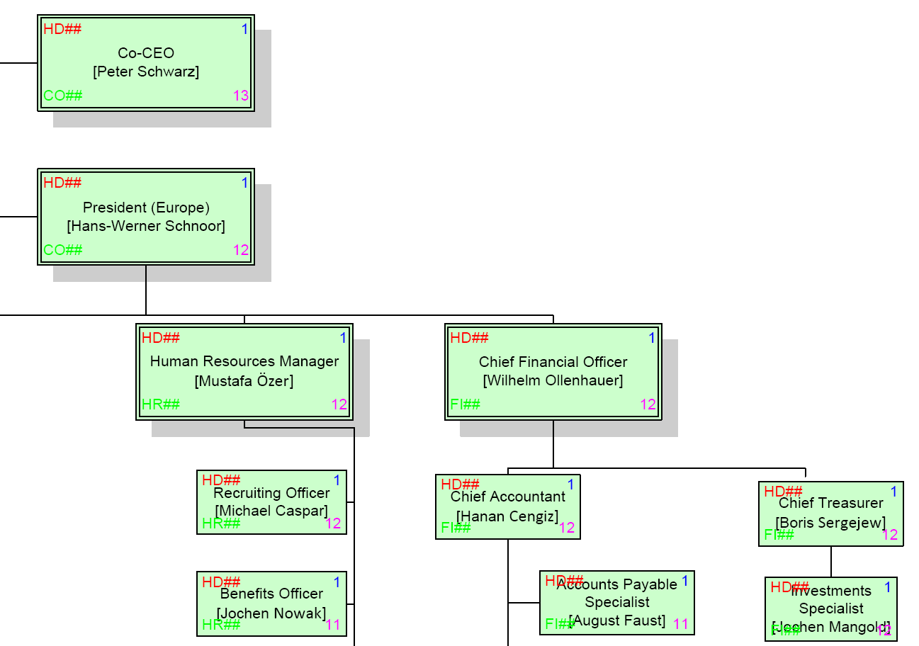
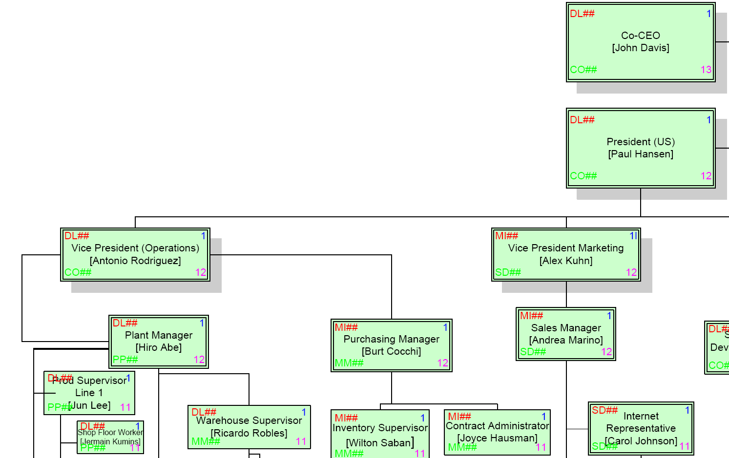
Organizational Structure (Human Resources)
Employees (US and Germany)

Slide 11
Agenda
Global Bike Group
Organizational Structure
Products
Business Partners
Business Processes

Slide 12
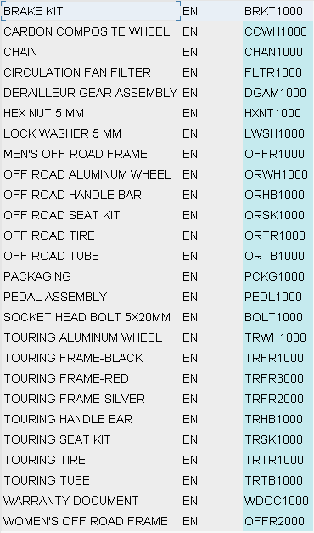
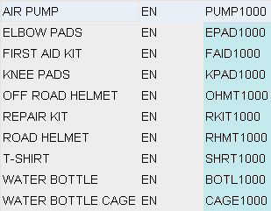
Products
Trading Goods
Accessories
Safety Gear
Other
Raw Materials

Slide 13
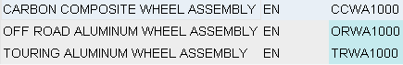
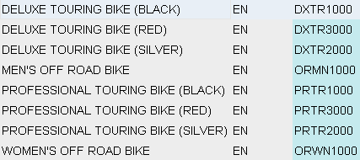
Products
Semi-Finished Goods
Finished Goods
Touring Bikes (Deluxe, Professional) in three colors
Off-Road Bikes (Men, Women)

Slide 14
Agenda
Global Bike Group
Organizational Structure
Products
Business Partners
Business Processes

Slide 15
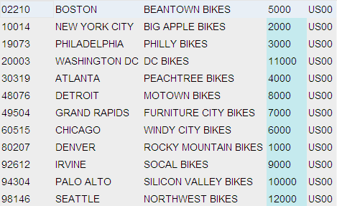
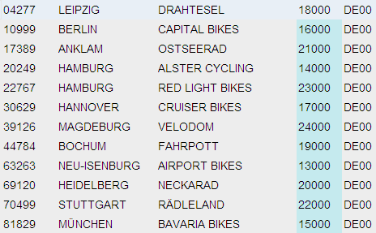
Business Partners
Customers (US and Germany)

Slide 16
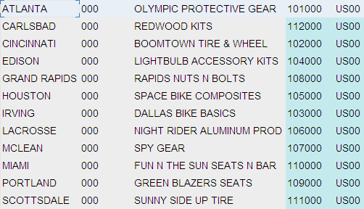
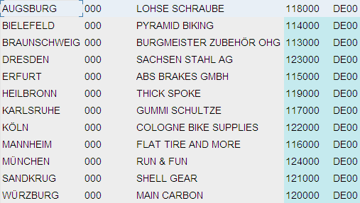
Business Partners
Vendors (US and Germany)

Slide 17
Agenda
Global Bike Group
Organizational Structure
Products
Business Partners
Business Processes

Slide 18
Business Processes
Sell – Fulfillment
Buy – Procurement
Make – Production
Track – Financial Accounting
Track – Controlling
People – Human Capital Management
Store – Inventory and Warehouse Management
Maintain – Enterprise Asset Management
Service – Customer Service
Project – Project Management

Slide 19
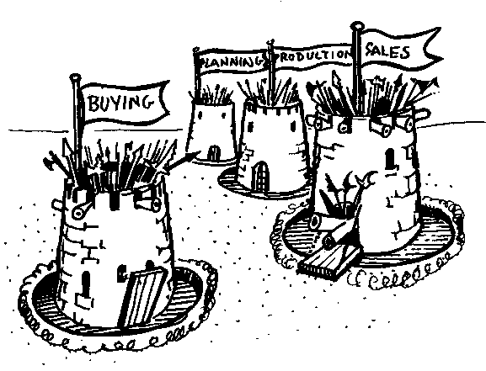
Cross-functional Integration
Notes:
ERP - Enterprise Resource Planning - breaks down the traditional barrier that exist within a corporation. For anyone to benefit from ERP, everyone has to contribute, this is the key to ERP survival.
There has to be a common agenda throughout the business. To get the commitment from everyone, everyone has to believe their needs and objectives are addressed by the plan, learning the tools and techniques to accomplish this is then relatively easy.

Slide 20
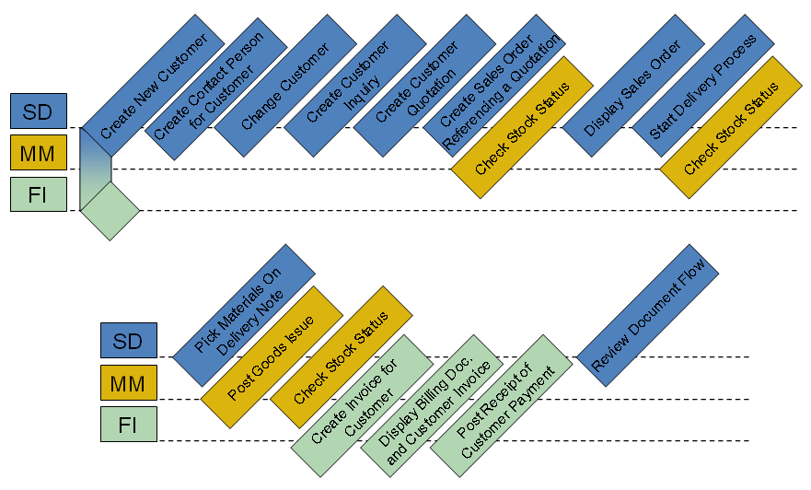
Process Integration (Example)
Order-to-Cash Process
Sales and Distribution (SD)
Materials Management (MM)
Financial Accounting (FI)

Slide 21
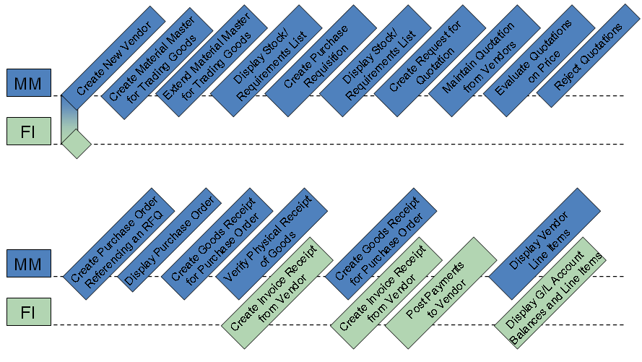
Process Integration (Example)
Procure-to-Cash Process
Materials Management (MM)
Financial Accounting (FI)

